Slide 1
Hashing

Slide 2
The Search Problem
Find items with keys matching a given search key
Given an array A, containing n keys, and a search key x, find the index i such as x=A[i]
As in the case of sorting, a key could be part of a large record.

Slide 3
Applications
Keeping track of customer account information at a bank
Search through records to check balances and perform transactions
Keep track of reservations on flights
Search to find empty seats, cancel/modify reservations
Search engine
Looks for all documents containing a given word

Slide 4
Special Case: Dictionaries
Dictionary = data structure that supports mainly two basic operations: insert a new item and return an item with a given key
Queries: return information about the set S:
Search (S, k)
Minimum (S), Maximum (S)
Successor (S, x), Predecessor (S, x)
Modifying operations: change the set
Insert (S, k)
Delete (S, k) – not very often

Slide 5
Direct Addressing
Assumptions:
Key values are distinct
Each key is drawn from a universe U = {0, 1, . . . , m - 1}
Idea:
Store the items in an array, indexed by keys
Direct-address table representation:
An array T[0 . . . m - 1]
Each slot, or position, in T corresponds to a key in U
For an element x with key k, a pointer to x (or x itself) will be placed in location T[k]
If there are no elements with key k in the set, T[k] is empty, represented by NIL

Slide 6
Hashing
Hashing: Hashing is a popular technique for storing and retrieving data as fast as possible. The main reason behind using hashing is that it gives optimal results as it performs optimal searches.
Hashing is a technique to convert a range of key values into a range of indexes of an array. We're going to use modulo operator to get a range of key values. Consider an example of hash table of size 20, and the following items are to be stored. Item are in the (key,value) format.

Slide 7
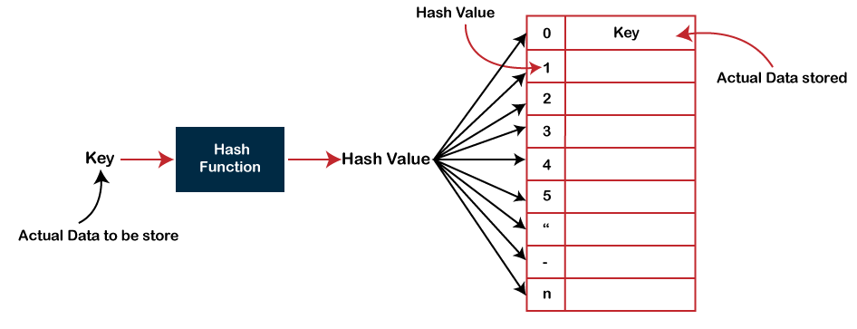

Slide 8
Why to use Hashing?
In a balanced binary search tree, if we try to search , insert or delete any element then the time complexity for the same is O(logn).
Now there might be a situation when our applications want to do the same operations in a faster way i.e. in a more optimized way and here hashing comes into play.
In hashing, all the above operations can be performed in O(1) i.e. constant time. It is important to understand that the worst case time complexity for hashing remains O(n) but the average case time complexity is O(1).

Slide 9
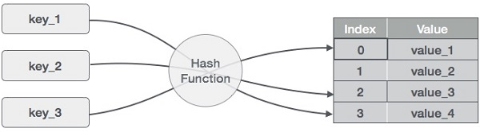

Slide 10
Sr.No. | Key | Hash | Array Index
1 | 1 | 1 % 20 = 1 | 1
2 | 2 | 2 % 20 = 2 | 2
3 | 42 | 42 % 20 = 2 | 2
4 | 4 | 4 % 20 = 4 | 4
5 | 12 | 12 % 20 = 12 | 12
6 | 14 | 14 % 20 = 14 | 14
7 | 17 | 17 % 20 = 17 | 17
8 | 13 | 13 % 20 = 13 | 13
9 | 37 | 37 % 20 = 17 | 17
(1,20)
(2,70)
(42,80)
(4,25)
(12,44)
(14,32)
(17,11)
(13,78)
(37,98)

Slide 11
A Function that translates keys to array indices is known as a hash function. The keys should be evenly distributed across the array via a decent hash function to reduce collisions and ensure quick lookup speeds.
Integer universe assumption: The keys are assumed to be integers within a certain range according to the integer universe assumption. This enables the use of basic hashing operations like division or multiplication hashing.
Hashing by division: This hashing technique uses the key’s remaining value after dividing it by the array’s size as the index. When an array size is a prime number and the keys are evenly spaced out, it performs well.
Hashing by multiplication: This hashing operation multiplies the key by a constant between 0 and 1 before taking the fractional portion of the outcome. After that, the index is determined by multiplying the fractional component by the array’s size. Also, it functions effectively when the keys are scattered equally.

Slide 12
Linear Probing
hashing technique is used to create an already used index of the array. In such a case, we can search the next empty location in the array by looking into the next cell until we find an empty cell. This technique is called linear probing.

Slide 13
Sr.No. | Key | Hash | Array Index | After Linear Probing, Array Index
1 | 1 | 1 % 20 = 1 | 1 | 1
2 | 2 | 2 % 20 = 2 | 2 | 2
3 | 42 | 42 % 20 = 2 | 2 | 3
4 | 4 | 4 % 20 = 4 | 4 | 4
5 | 12 | 12 % 20 = 12 | 12 | 12
6 | 14 | 14 % 20 = 14 | 14 | 14
7 | 17 | 17 % 20 = 17 | 17 | 17
8 | 13 | 13 % 20 = 13 | 13 | 13
9 | 37 | 37 % 20 = 17 | 17 | 18

Slide 14
Direct Addressing (cont’d)

Slide 15
Basic Operations
Search − Searches an element in a hash table.
Insert − inserts an element in a hash table.
delete − Deletes an element from a hash table.

Slide 16
Operations
Alg.: DIRECT-ADDRESS-SEARCH(T, k)
return T[k]
Alg.: DIRECT-ADDRESS-INSERT(T, x)
T[key[x]] ← x
Alg.: DIRECT-ADDRESS-DELETE(T, x)
T[key[x]] ← NIL
Running time for these operations: O(1)

Slide 17
Comparing Different Implementations
Implementing dictionaries using:
Direct addressing
Ordered/unordered arrays
Ordered/unordered linked lists
Insert
Search
direct addressing
O(1)
O(1)
ordered array
O(N)
O(lgN)
ordered list
O(N)
O(N)
unordered array
O(1)
O(N)
unordered list
O(1)
O(N)

Slide 18
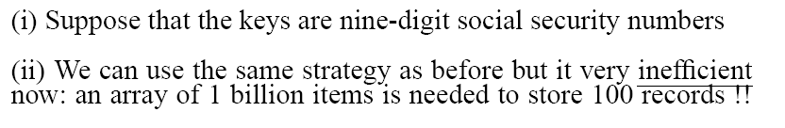
Examples Using Direct Addressing
Example 1:
Example 2:

Slide 19
Hash Tables
When K is much smaller than U, a hash table requires much less space than a direct-address table
Can reduce storage requirements to |K|
Can still get O(1) search time, but on the average case, not the worst case

Slide 20
Hash Tables
Idea:
Use a function h to compute the slot for each key
Store the element in slot h(k)
A hash function h transforms a key into an index in a hash table T[0…m-1]:
h : U → {0, 1, . . . , m - 1}
We say that k hashes to slot h(k)
Advantages:
Reduce the range of array indices handled: m instead of |U|
Storage is also reduced

Slide 21
Example: HASH TABLES
0
U
(universe of keys)
h(k₁)
h(k₄)
k₁
K
(actual
keys)
k₄
k₂
h(k₂) = h(k₅)
k₅
k₃
h(k₃)
m - 1

Slide 22
Collisions
0
U
(universe of keys)
h(k₁)
h(k₄)
k₁
K
(actual
keys)
k₄
k₂
h(k₂) = h(k₅)
Collisions!
k₅
k₃
h(k₃)
m - 1

Slide 23
Collisions
Two or more keys hash to the same slot!!
For a given set K of keys
If |K| ≤ m, collisions may or may not happen, depending on the hash function
If |K| > m, collisions will definitely happen (i.e., there must be at least two keys that have the same hash value)
Avoiding collisions completely is hard, even with a good hash function

Slide 24
Handling Collisions
We will review the following methods:
Chaining
Open addressing
Linear probing
Quadratic probing
Double hashing
We will discuss chaining first, and ways to build “good” functions.

Slide 25
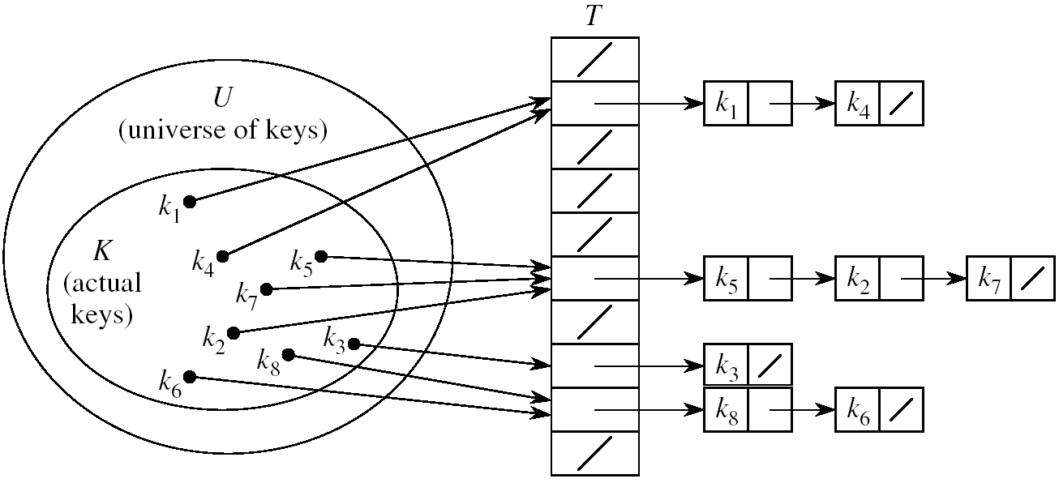
Handling Collisions Using Chaining
Idea:
Put all elements that hash to the same slot into a linked list
Slot j contains a pointer to the head of the list of all elements that hash to j

Slide 26
Collision with Chaining - Discussion
Choosing the size of the table
Small enough not to waste space
Large enough such that lists remain short
Typically 1/5 or 1/10 of the total number of elements
How should we keep the lists: ordered or not?
Not ordered!
Insert is fast
Can easily remove the most recently inserted elements

Slide 27
Insertion in Hash Tables
Alg.: CHAINED-HASH-INSERT(T, x)
insert x at the head of list T[h(key[x])]
Worst-case running time is O(1)
Assumes that the element being inserted isn’t already in the list
It would take an additional search to check if it was already inserted

Slide 28
Deletion in Hash Tables
Alg.: CHAINED-HASH-DELETE(T, x)
delete x from the list T[h(key[x])]
Need to find the element to be deleted.
Worst-case running time:
Deletion depends on searching the corresponding list

Slide 29
Searching in Hash Tables
Alg.: CHAINED-HASH-SEARCH(T, k)
search for an element with key k in list T[h(k)]
Running time is proportional to the length of the list of elements in slot h(k)

Slide 30
Hash Functions
A hash function transforms a key into a table address
What makes a good hash function?
(1) Easy to compute
(2) Approximates a random function: for every input, every output is equally likely
In practice, it is very hard to satisfy the simple uniform hashing property
i.e., we don’t know in advance the probability distribution that keys are drawn from

Slide 31
The Division Method
Idea:
Map a key k into one of the m slots by taking the remainder of k divided by m
h(k) = k mod m
Advantage:
fast, requires only one operation
Disadvantage:
Certain values of m are bad, e.g.,
power of 2
non-prime numbers

Slide 32
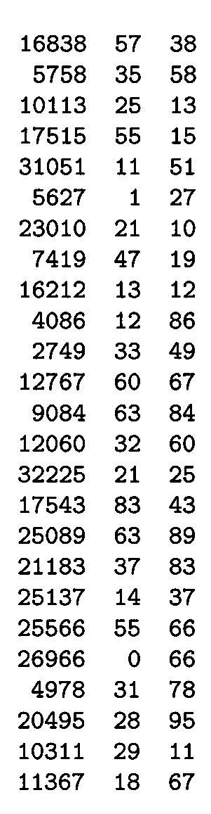
Example - The Division Method
m97
m
100
If m = 2^{p}, then h(k) is just the least significant p bits of k
p = 1 ⇒ m = 2
⇒ h(k) = , least significant 1 bit of k
p = 2 ⇒ m = 4
⇒ h(k) = , least significant 2 bits of k
Choose m to be a prime, not close to a
power of 2
Column 2:
Column 3:
{0, 1}
{0, 1, 2, 3}
k mod 97
k mod 100

Slide 33

The Multiplication Method
Idea:
Multiply key k by a constant A, where 0 < A < 1
Extract the fractional part of kA
Multiply the fractional part by m
Take the floor of the result
h(k) = = ⎣m (k A mod 1)⎦
Disadvantage: Slower than division method
Advantage: Value of m is not critical, e.g., typically 2^{p}
fractional part of kA = kA - ⎣kA⎦

Slide 34
Example – Multiplication Method

Slide 35
Universal Hashing
In practice, keys are not randomly distributed
Any fixed hash function might yield Θ(n) time
Goal: hash functions that produce random table indices irrespective of the keys
Idea:
Select a hash function at random, from a designed class of functions at the beginning of the execution

Slide 36
Universal Hashing
(at the beginning
of the execution)

Slide 37
Definition of Universal Hash Functions
H={h(k): U→(0,1,..,m-1)}

Slide 38
Open Addressing
If we have enough contiguous memory to store all the keys (m > N) ⇒ store the keys in the table itself
No need to use linked lists anymore
Basic idea:
Insertion: if a slot is full, try another one,
until you find an empty one
Search: follow the same sequence of probes
Deletion: more difficult ... (we’ll see why)
Search time depends on the length of the
probe sequence!
e.g., insert 14

Slide 39
Generalize hash function notation:
A hash function contains two arguments now:
(i) Key value, and (ii) Probe number
h(k,p), p=0,1,...,m-1
Probe sequences
<h(k,0), h(k,1), ..., h(k,m-1)>
Must be a permutation of <0,1,...,m-1>
There are m! possible permutations
Good hash functions should be able to
produce all m! probe sequences
insert 14
Example
<1, 5, 9>

Slide 40
Common Open Addressing Methods
Linear probing
Quadratic probing
Double hashing
Note: None of these methods can generate more than m² different probing sequences!

Slide 41
Linear probing: Inserting a key
Idea: when there is a collision, check the next available position in the table (i.e., probing)
h(k,i) = (h₁(k) + i) mod m
i=0,1,2,...
First slot probed: h₁(k)
Second slot probed: h₁(k) + 1
Third slot probed: h₁(k)+2, and so on
Can generate m probe sequences maximum, why?
probe sequence: < h1(k), h1(k)+1 , h1(k)+2 , ....>
wrap around

Slide 42
Linear probing: Searching for a key
Three cases:
(1) Position in table is occupied with an element of equal key
(2) Position in table is empty
(3) Position in table occupied with a different element
Case 2: probe the next higher index until the element is found or an empty position is found
The process wraps around to the beginning of the table
0
h(k₁)
h(k₄)
h(k₂) = h(k₅)
h(k₃)
m - 1

Slide 43
Linear probing: Deleting a key
Problems
Cannot mark the slot as empty
Impossible to retrieve keys inserted after that slot was occupied
Solution
Mark the slot with a sentinel value DELETED
The deleted slot can later be used for insertion
Searching will be able to find all the keys
0
m - 1

Slide 44
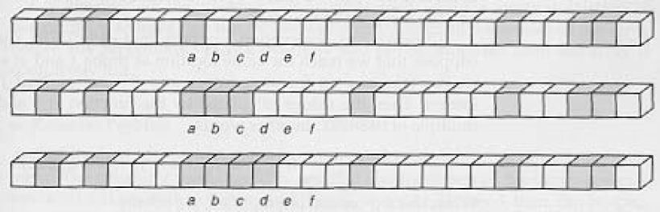
Primary Clustering Problem
Some slots become more likely than others
Long chunks of occupied slots are created
⇒ search time increases!!
initially, all slots have probability 1/m
Slot b:
2/m
Slot d:
4/m
Slot e:
5/m

Slide 45
Quadratic Probing
Quadratic probing eliminates the primary clustering problem
Assume hVal is the value of the hash function
Instead of linear probing which searches for an open slot in a linear fashion like this
hVal + 1, hVal + 2, hVal + 3, hVal + 4, ...
add index values in increments of powers of 2
hVal + 2¹, hVal + 2², hVal + 2³, hVal + 2⁴, ...

Slide 46
Does it work?
Quadratic probing works well if
1) table size is prime
studies show the prime numbered table size removes some of the non-randomness of hash functions
2) table is never more than half full
probes 1, 4, 9, 17, 33, 65, 129, ... slots away
So make your table twice as big as you need
insert, find, remove are O(1)
A space (memory) tradeoff:
4*n additional bytes required for unused array locations

Slide 47
Separate Chaining
Separate Chaining is an alternative to probing
How? Maintain an array of lists
Hash to the same place always and insert at the beginning (or end) of the linked list.
The list needs add and remove methods

Slide 48
Array of LinkedLists Data Structure
Each array element is a List
0
1
“AB” 9
“BA” 9
2

Slide 49
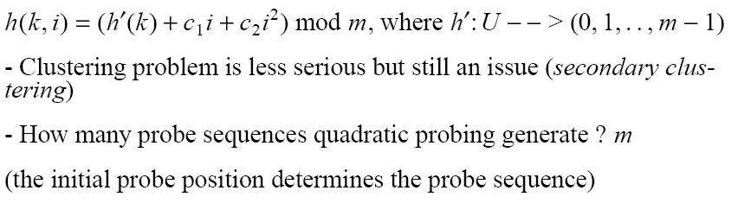
Quadratic probing
i=0,1,2,...

Slide 50
Double Hashing
(1) Use one hash function to determine the first slot
(2) Use a second hash function to determine the increment for the probe sequence
h(k,i) = (h₁(k) + i h₂(k) ) mod m, i=0,1,...
Initial probe: h₁(k)
Second probe is offset by h₂(k) mod m, so on ...
Advantage: avoids clustering
Disadvantage: harder to delete an element
Can generate m² probe sequences maximum

Slide 51
Double Hashing: Example
h₁(k) = k mod 13
h₂(k) = 1+ (k mod 11)
h(k,i) = (h₁(k) + i h₂(k) ) mod 13
Insert key 14:
h₁(14,0) = 14 mod 13 = 1
h(14,1) = (h₁(14) + h₂(14)) mod 13
= (1 + 4) mod 13 = 5
h(14,2) = (h₁(14) + 2 h₂(14)) mod 13
= (1 + 8) mod 13 = 9
0
79
69
98
72
50
1
2
3
4
5
6
7
8
9
14
10
11
12

